Slide 1
Missouri State Parks Recovery of 2019 Flooding
Presented by
Dustin Webb,
Missouri State Parks Northern Region

Slide 2
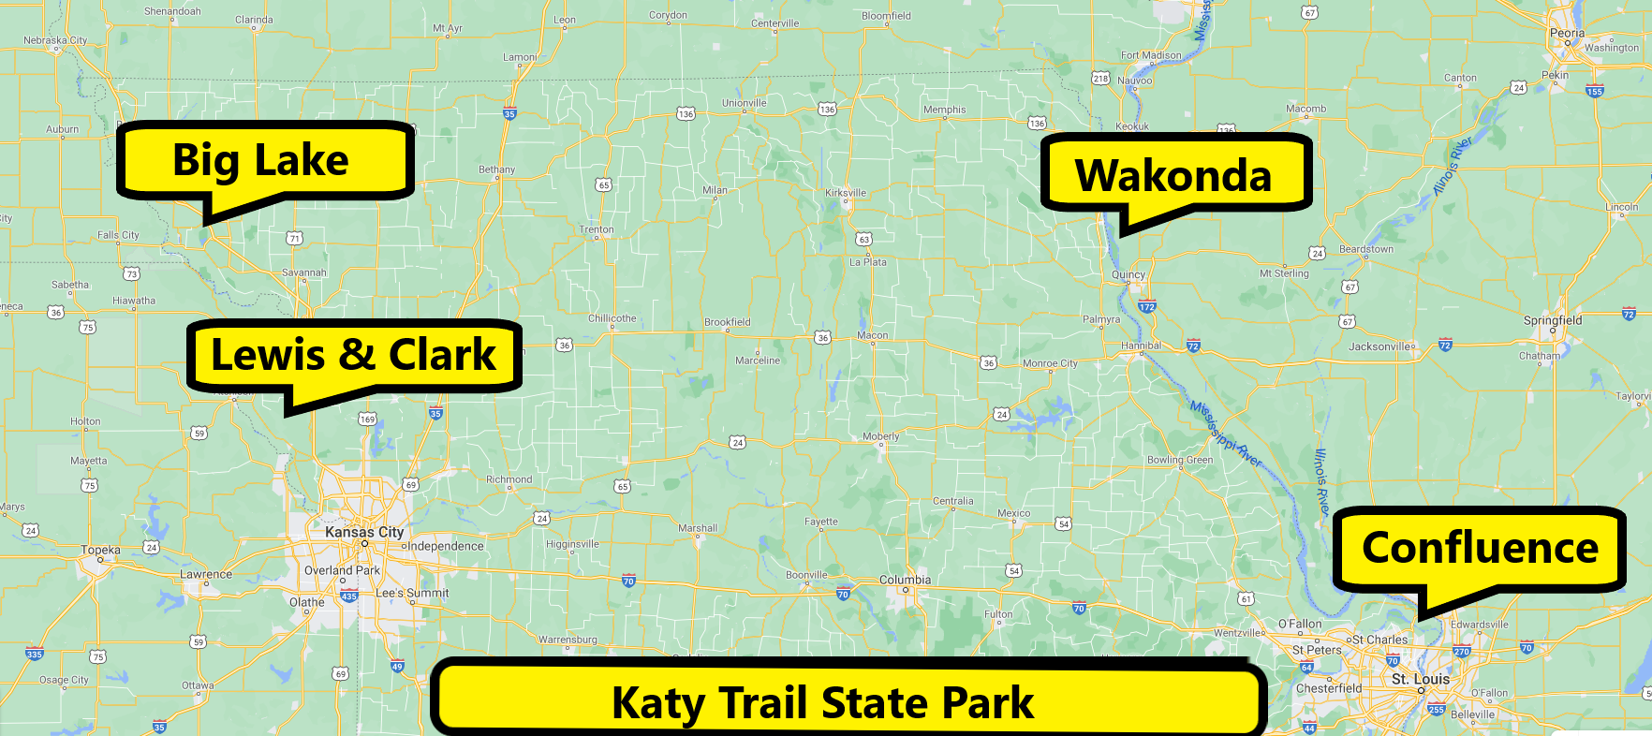
2019 Significant Flood Damage to Missouri State Parks

Slide 3
Wakonda State Park:
Lewis County, in LaGrange Mo.
1,054 Acres
2020 attendance:223,362
Overnight guest in 2020: 21,557
94 Campsites, both campgrounds sit on a lake in the park.
Kayak rentals
Swim beach
2 boat launches
Two rental shelter houses
17 miles of hiking trails
3 playgrounds
Rare sand prairies.
2019 Mississippi River Flooding shut park down until September of 2019.

Slide 4
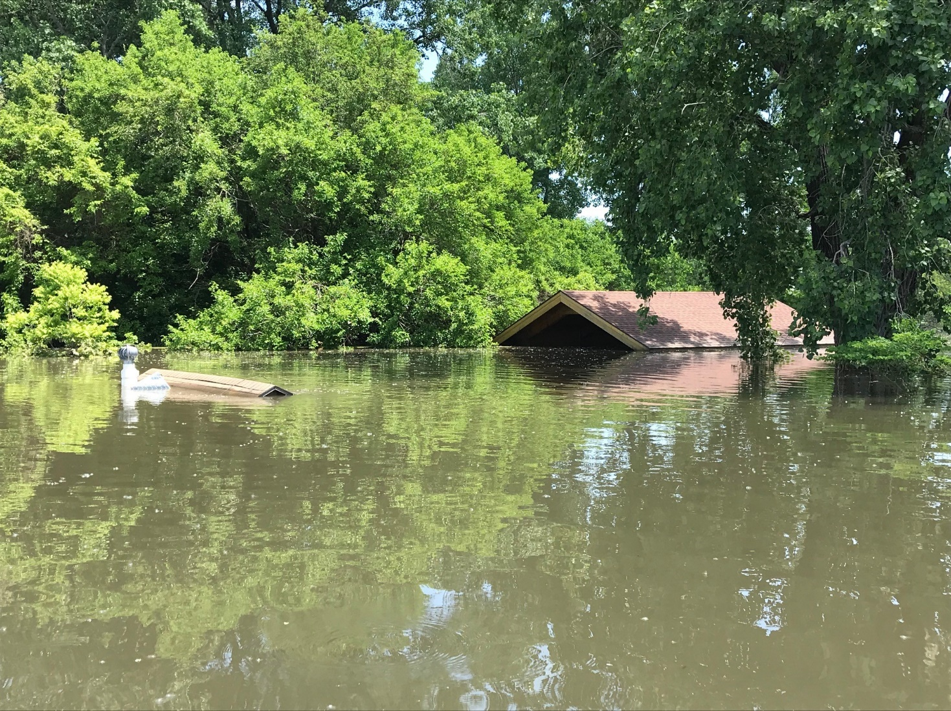

Slide 5
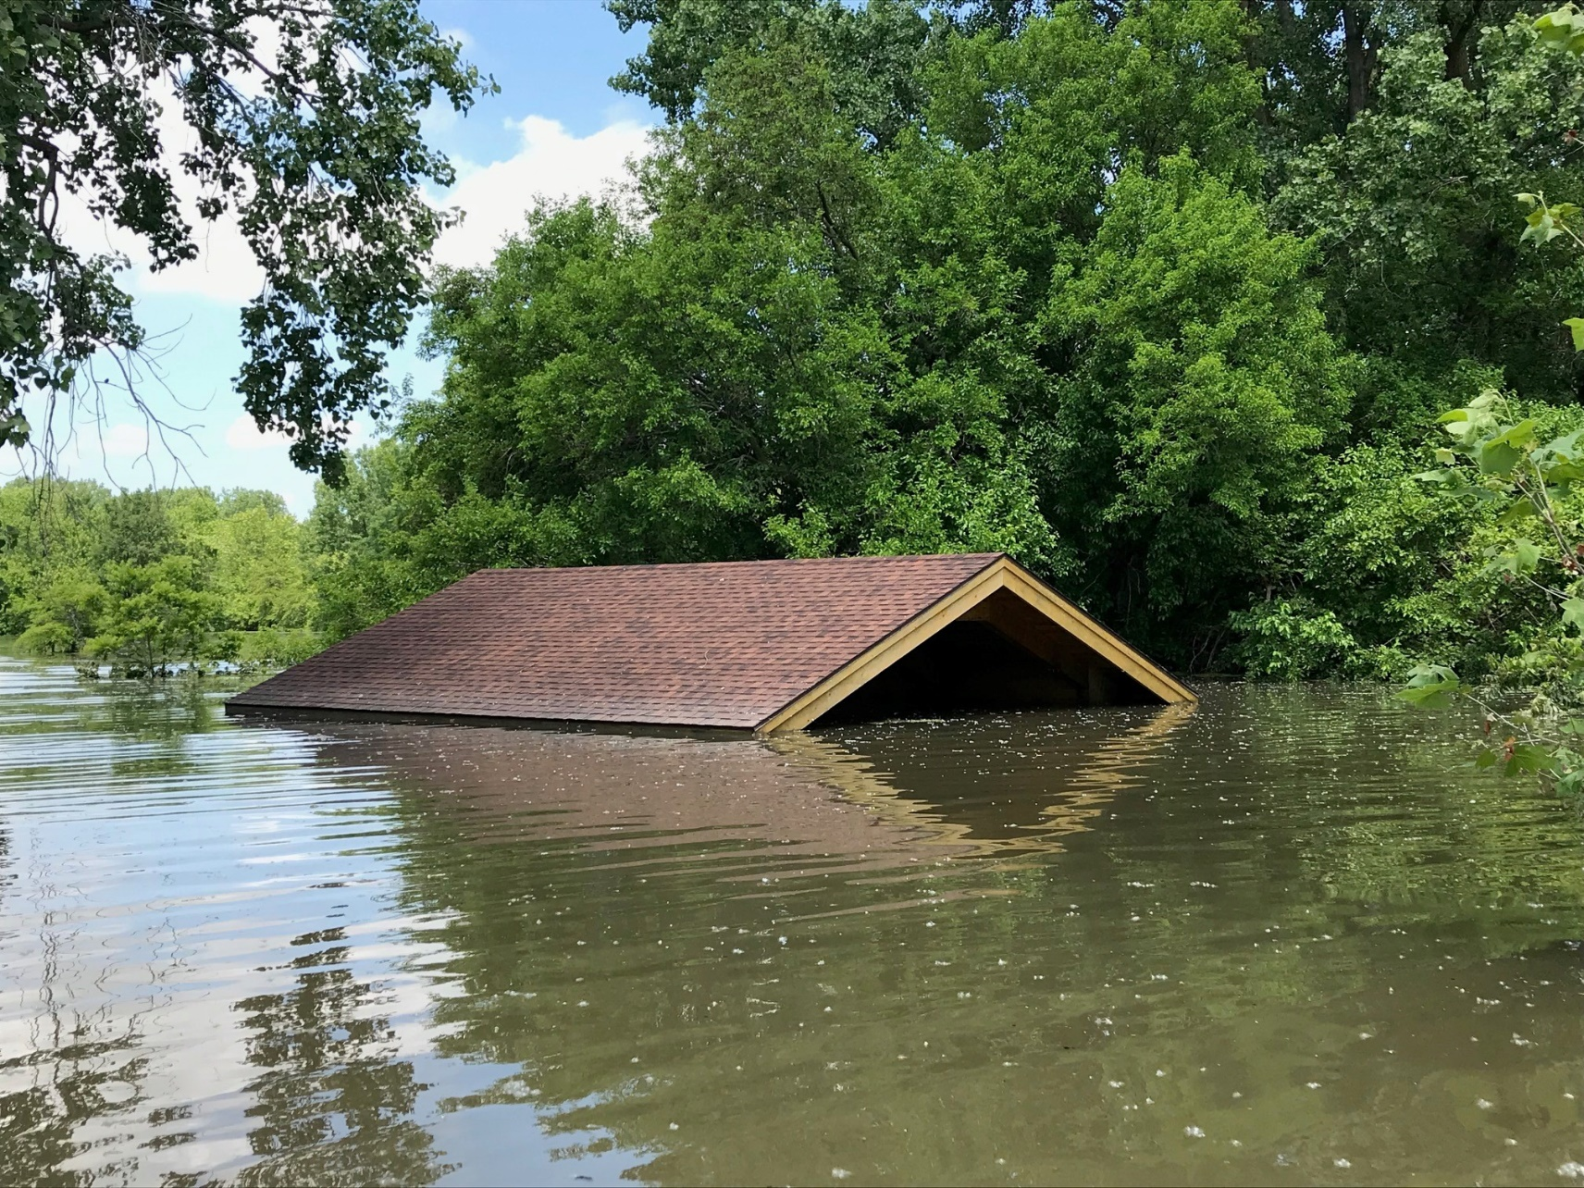

Slide 6
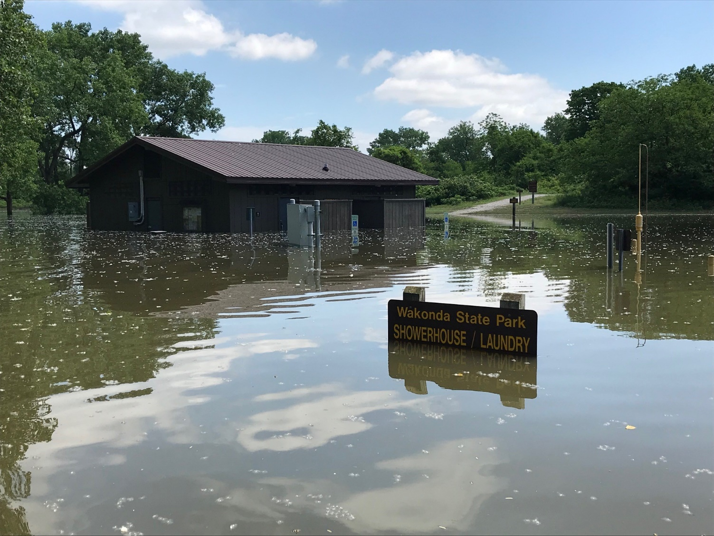

Slide 7
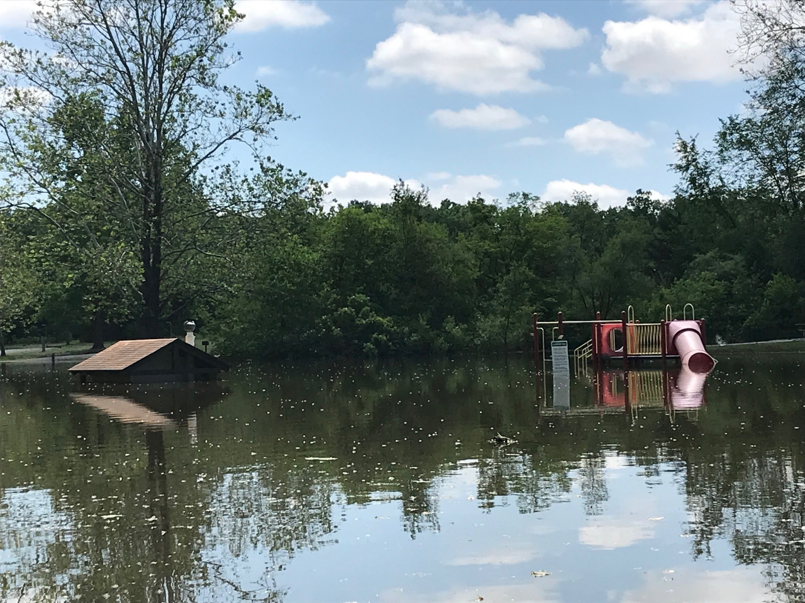

Slide 8
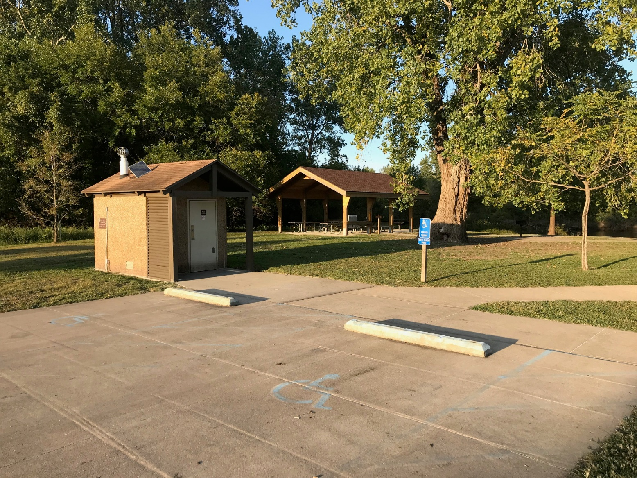

Slide 10
Edward “Ted” & Pat Jones-Confluence Point State Park:
St. Charles County.
1,121 acres
900 acres in active natural resource stewardship
Day use park.
Re-opened on Memorial Day Weekend 2021.

Slide 11
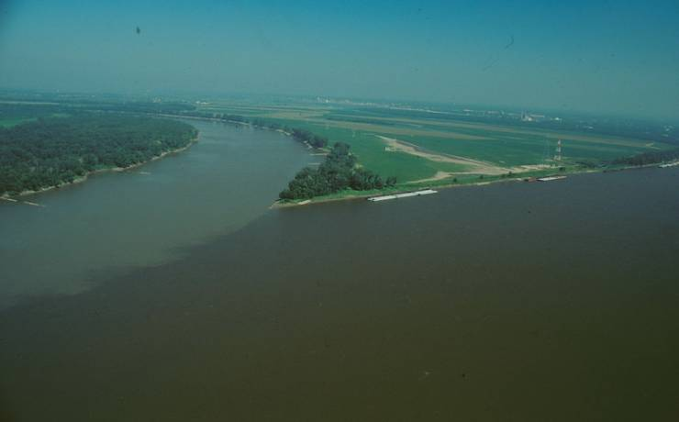
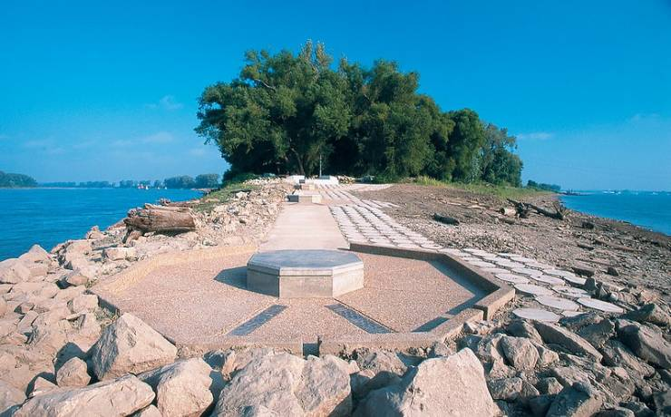

Slide 12
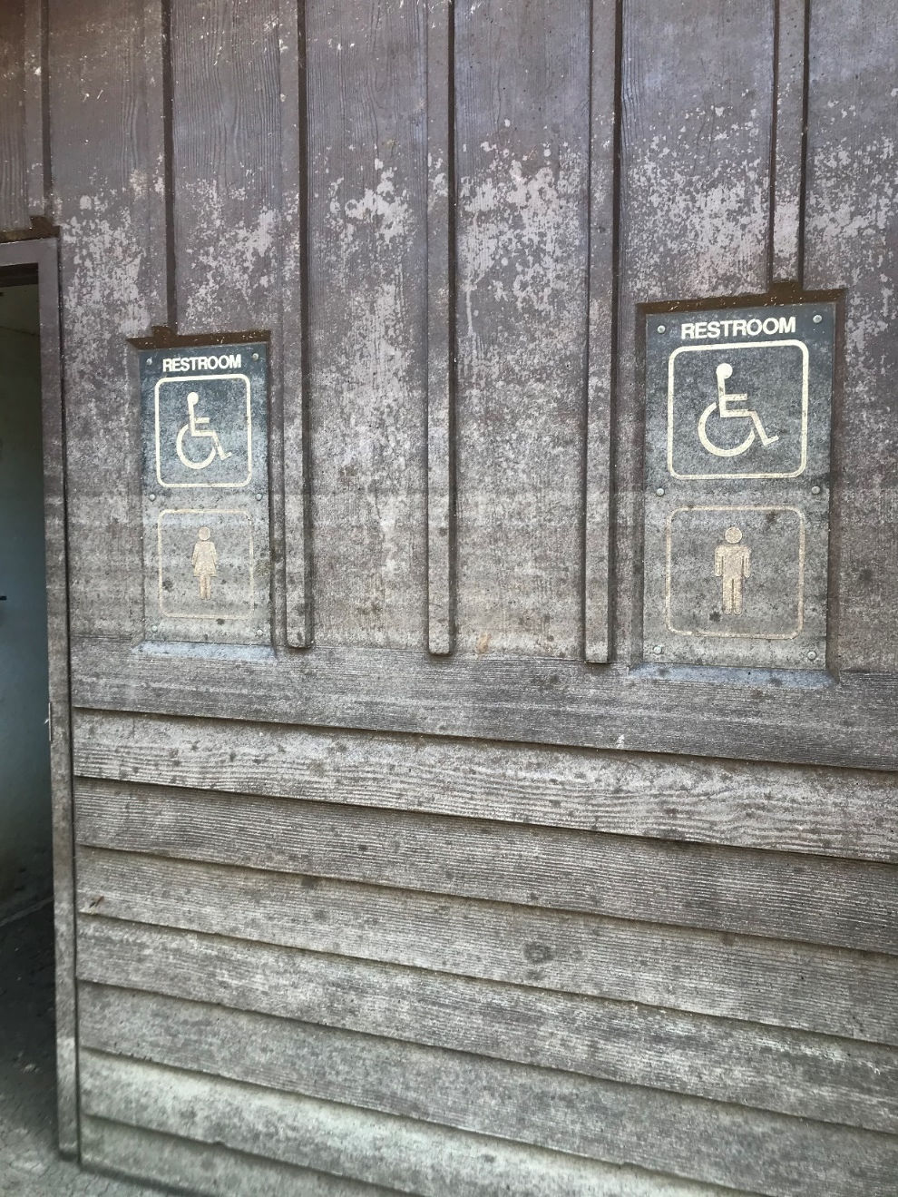
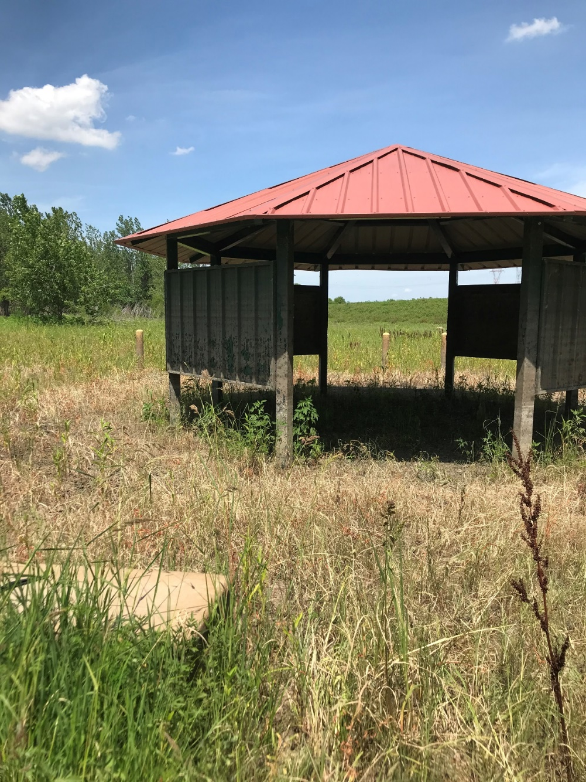

Slide 13
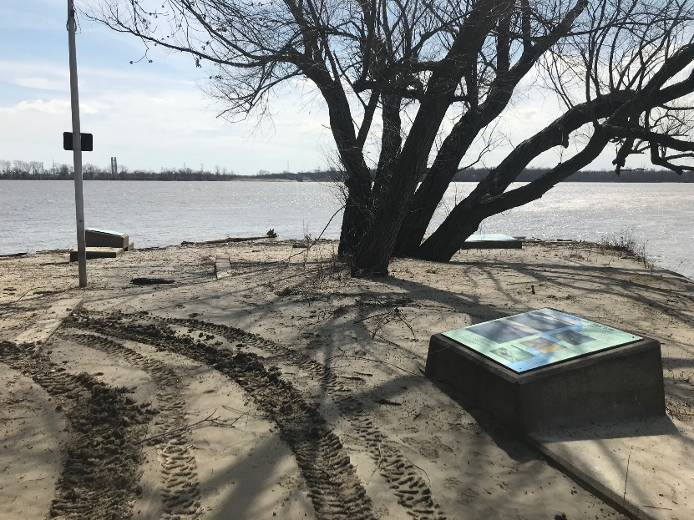
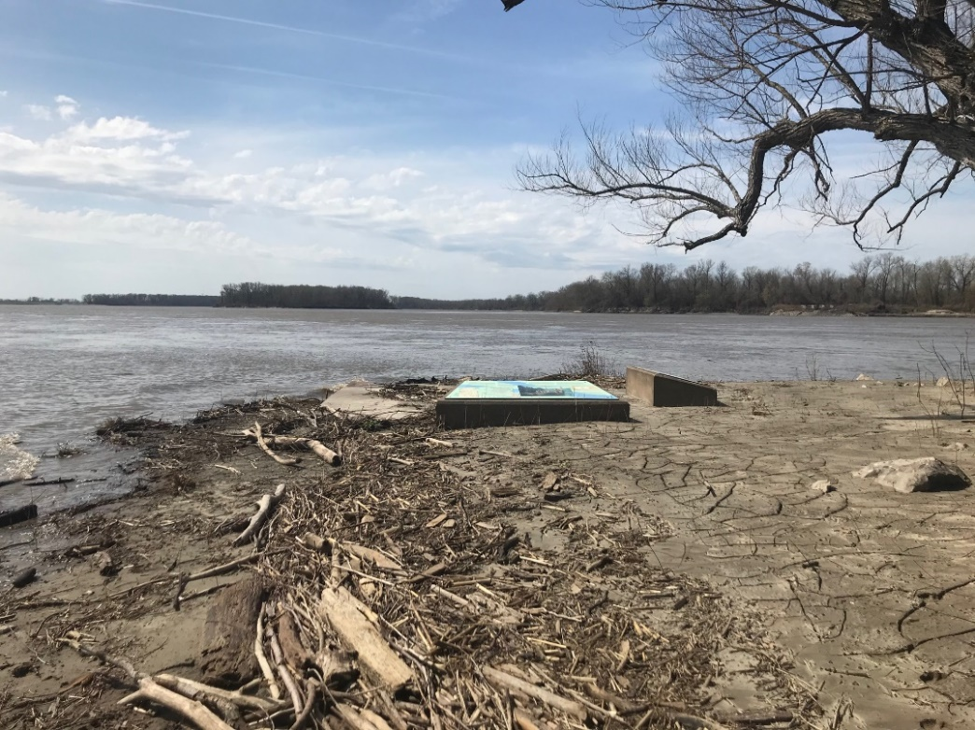

Slide 14
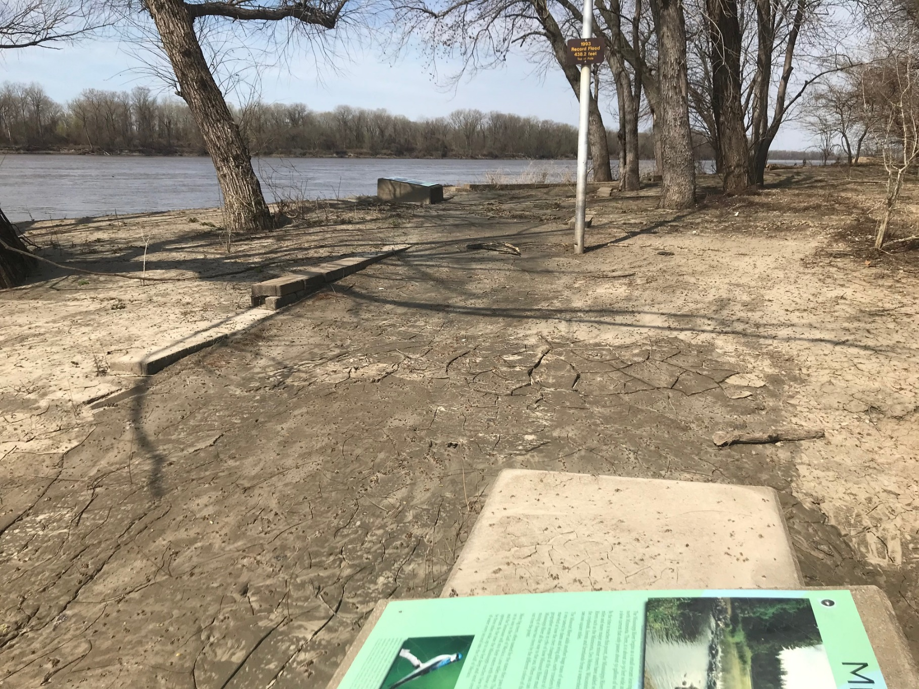

Slide 15
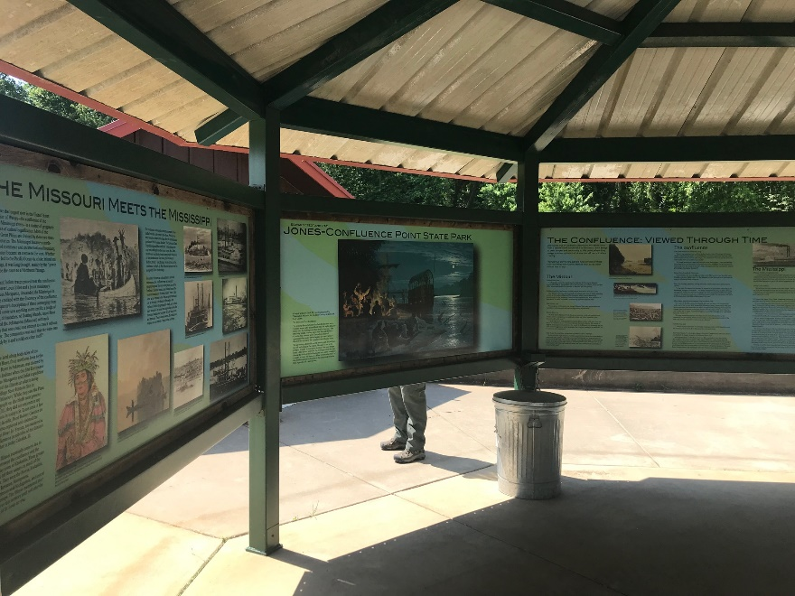
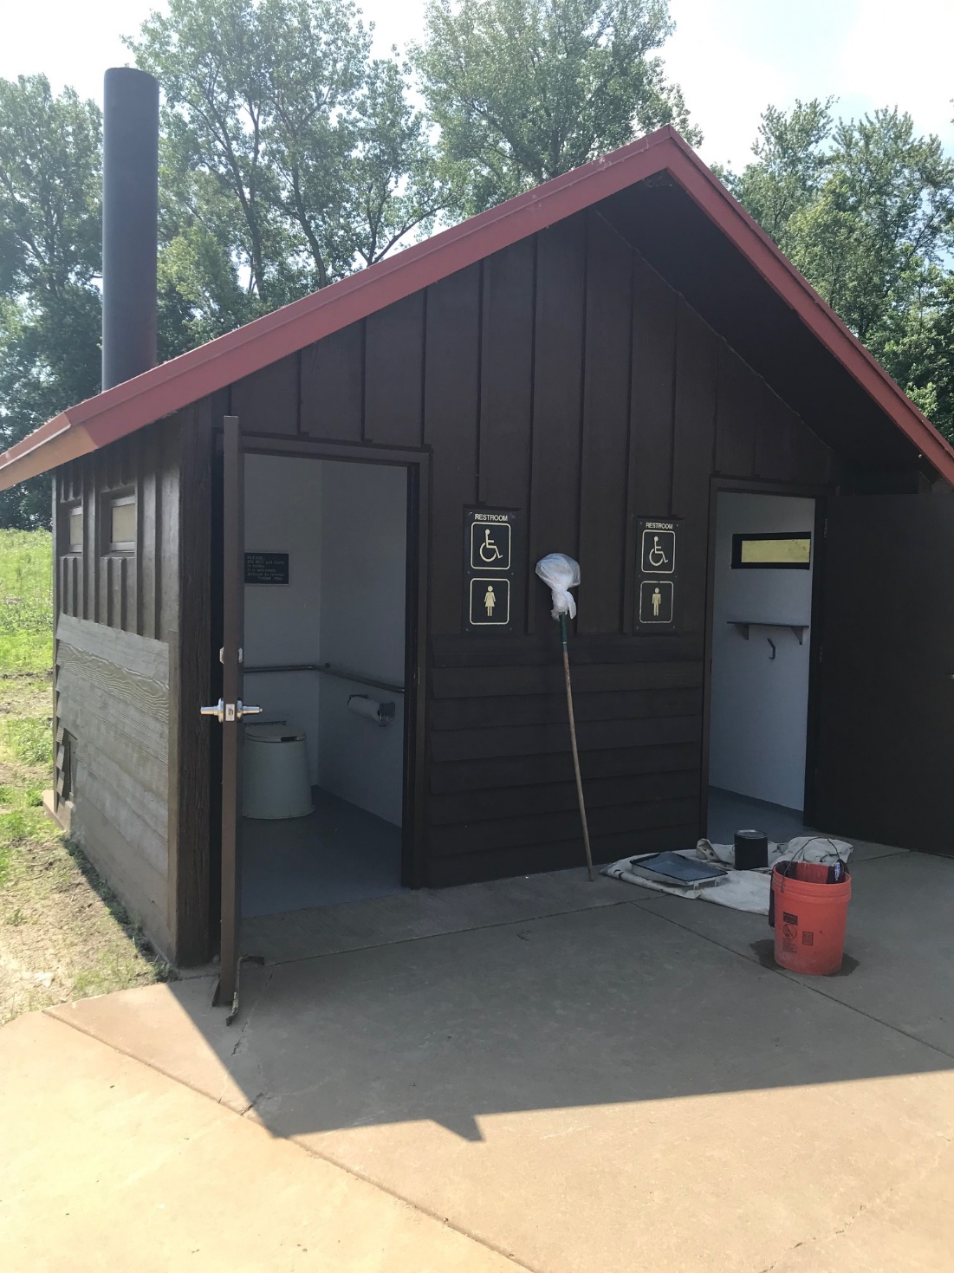
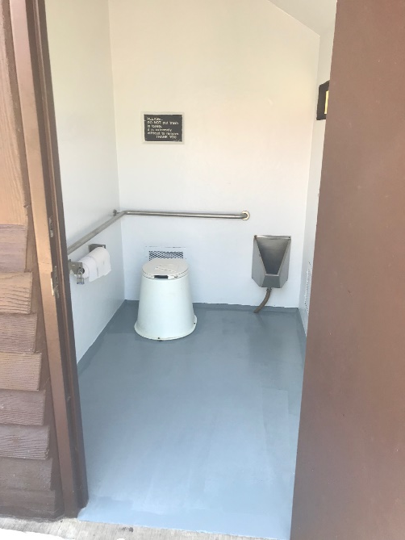

Slide 16
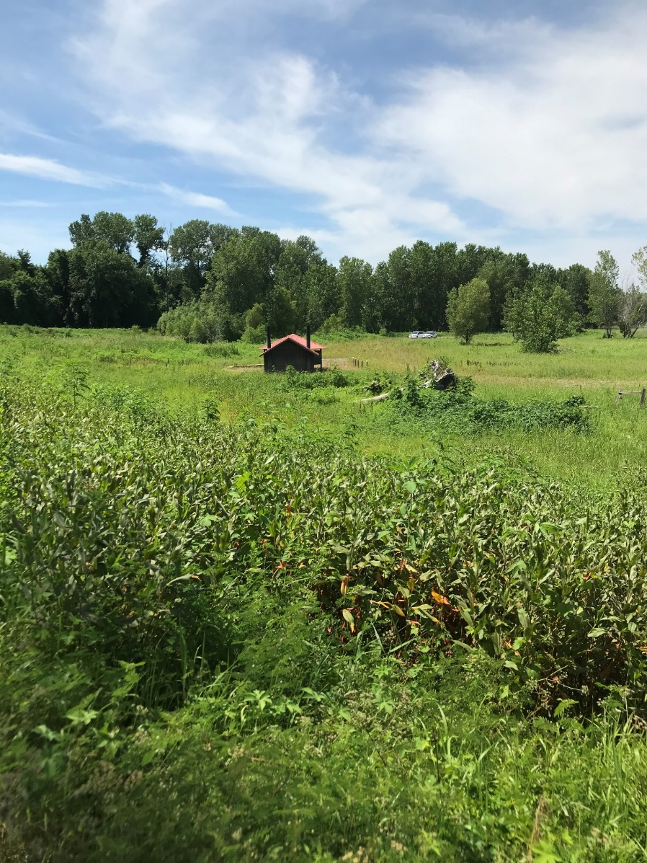
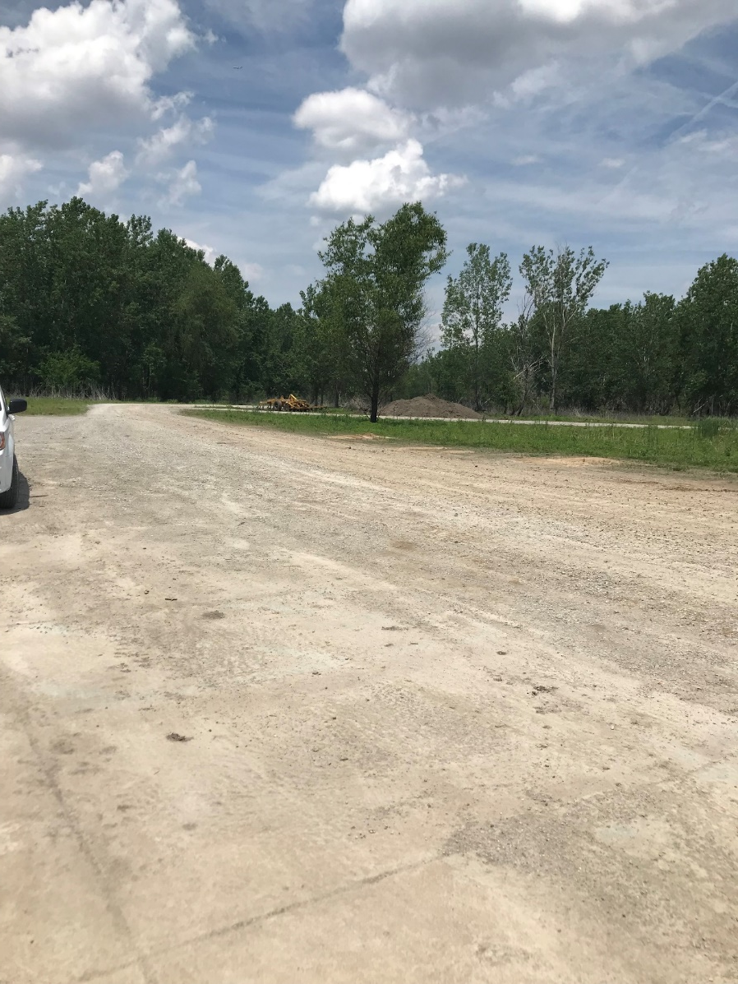

Slide 17
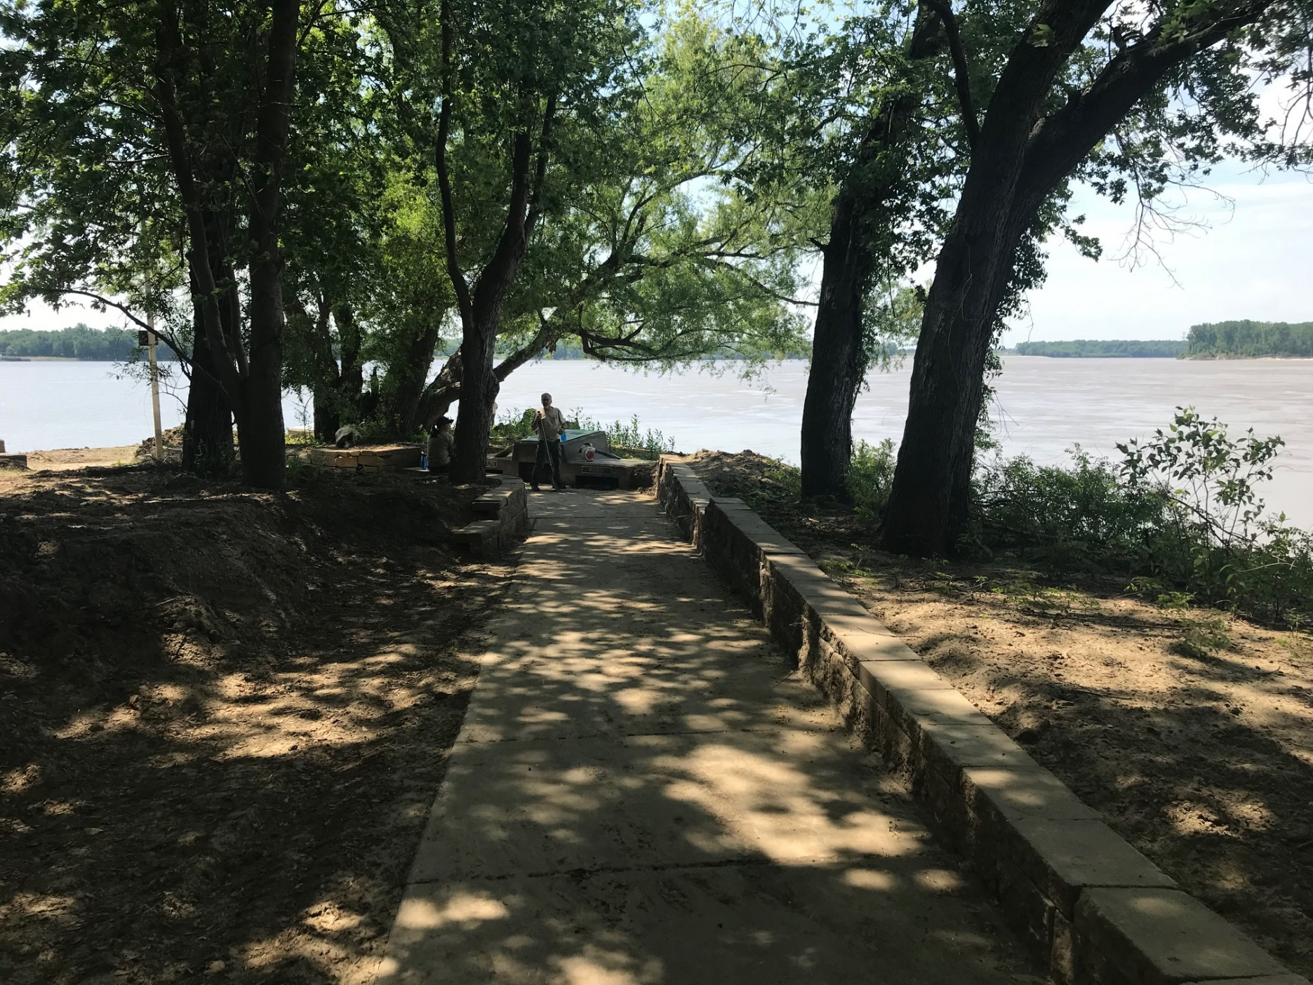

Slide 18
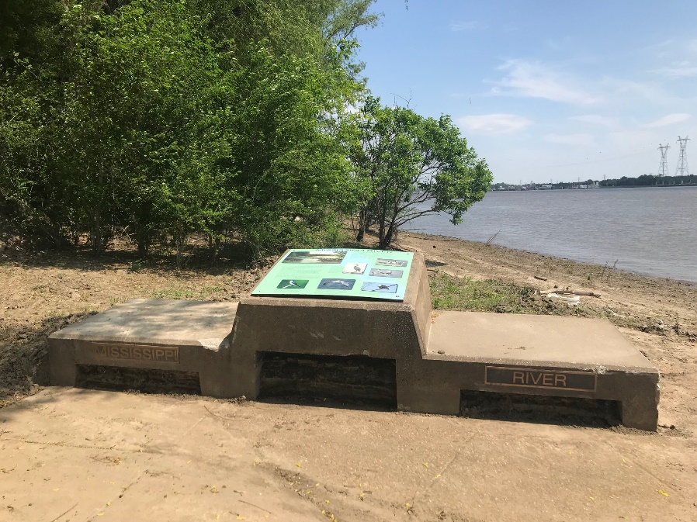
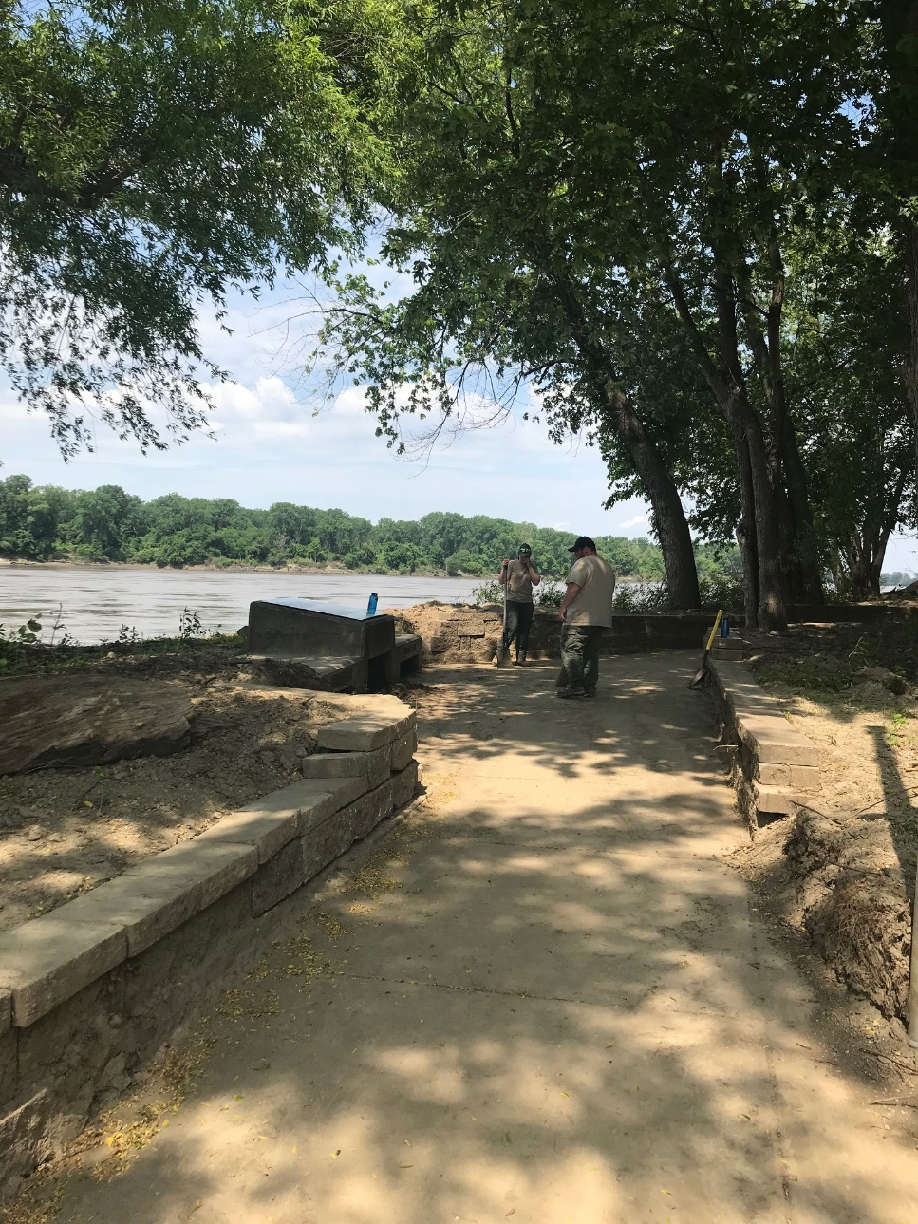
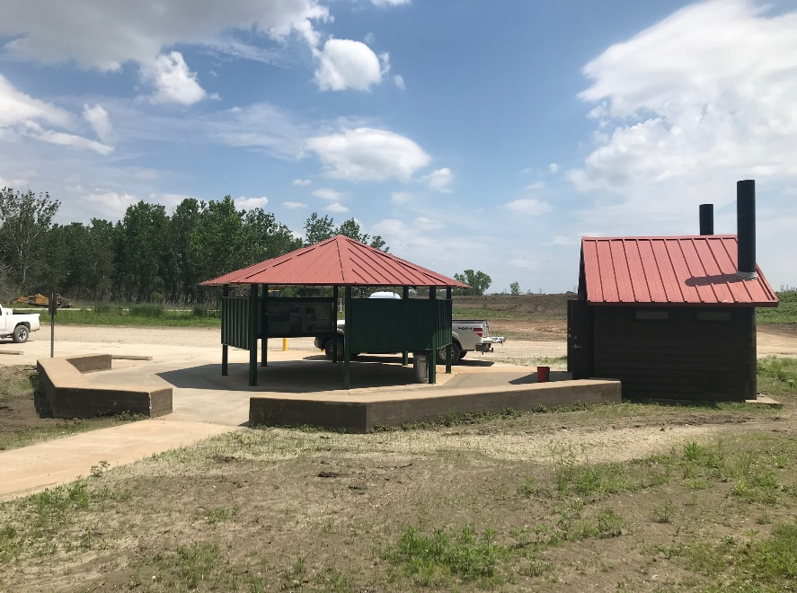

Slide 19
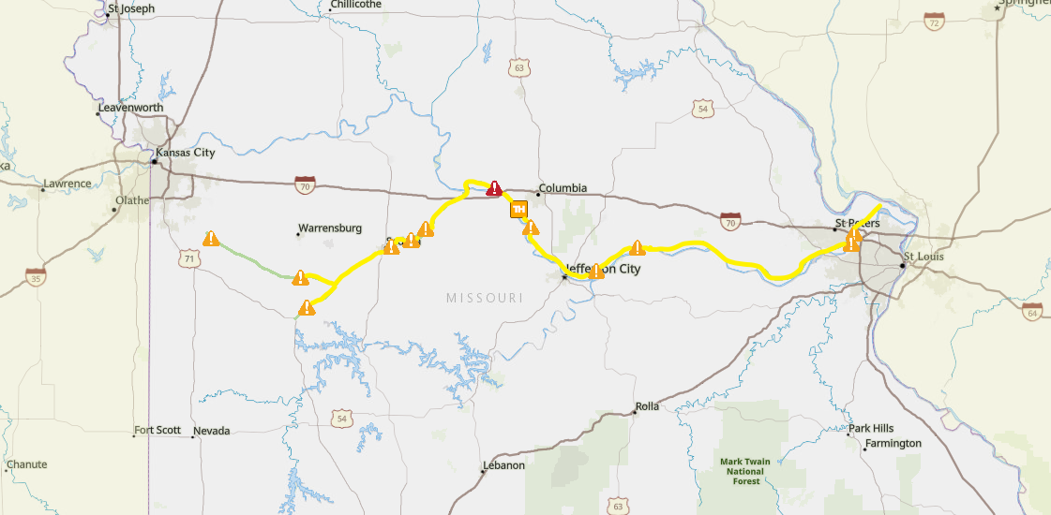
Katy Trail State Park

Slide 20
Katy Trail State Park:
Located in Boone, Callaway, Cass, Henry, Howard, Johnson, Montgomery, Pettis, St. Charles, and Warren Counties.
Katy Trail & Katy Trail Rock Island Extension- 286 mile rail to trail conversion on the former corridor of the Missouri-Kansas-Texas railroad. Runs between Clinton and Machens. The Katy Trail is very flood prone due to its proximity to the Missouri River in many sections. Localized flooding and Major River flooding both result in extensive damage and repairs on the trail.
Katy Trail is managed in sections by 4 different state parks.
2020 attendance: 551,050

Slide 21
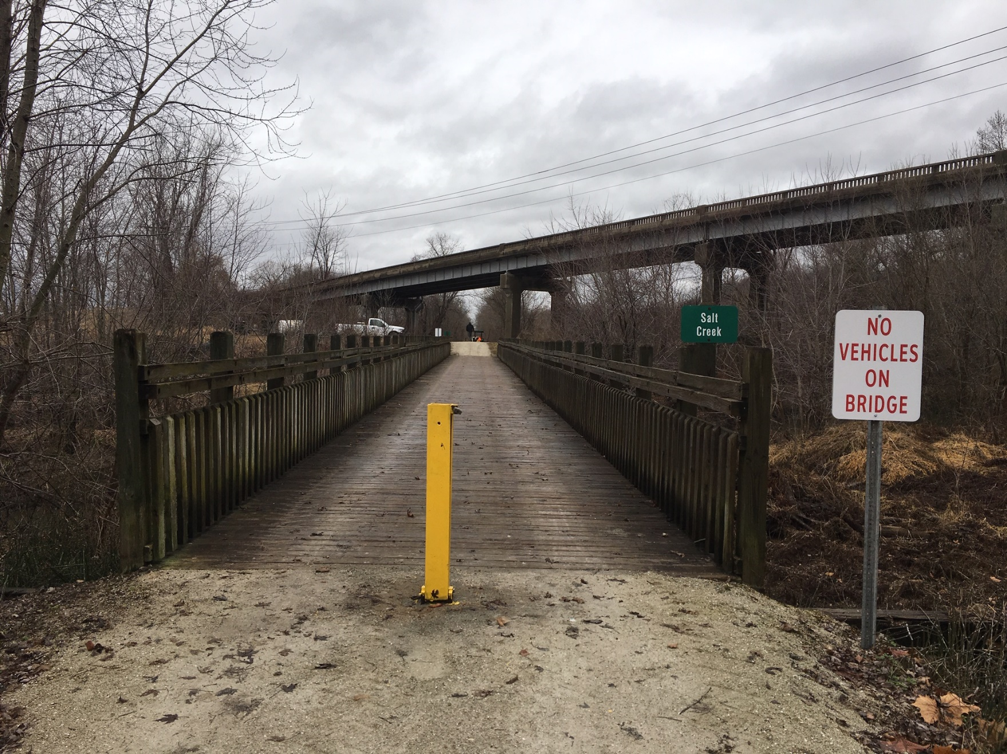

Slide 22
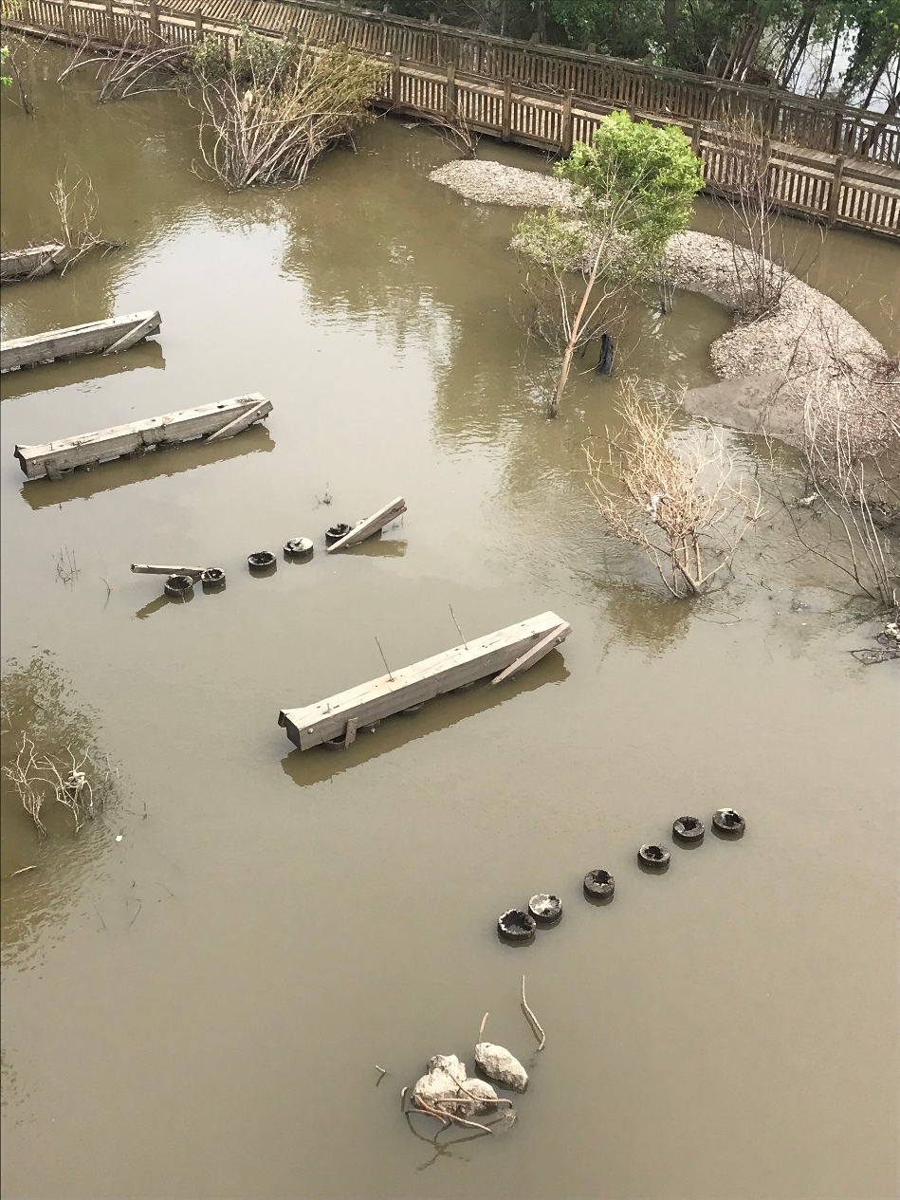

Slide 23
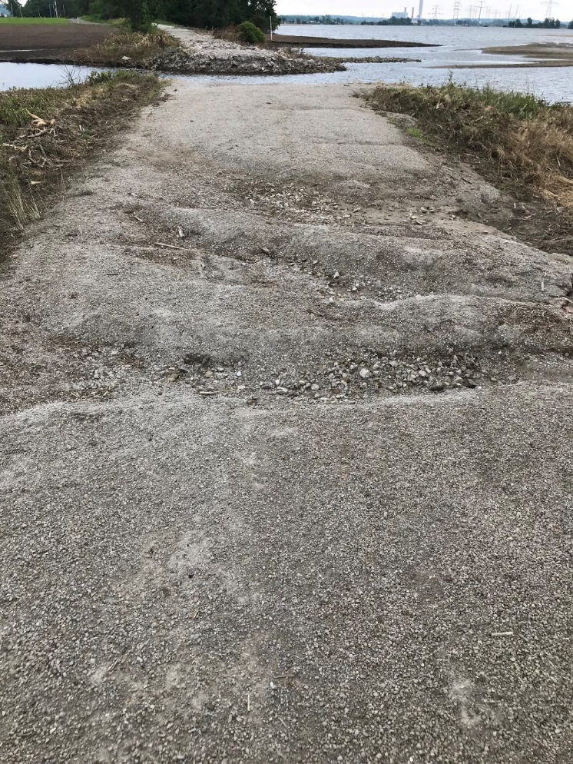
MM 27.5, Near Machens

Slide 24
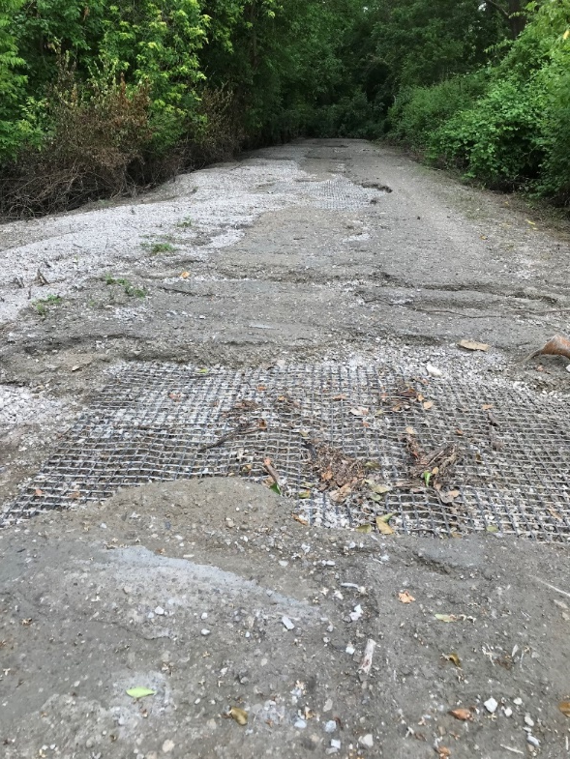
MM 35, near St. Charles

Slide 25
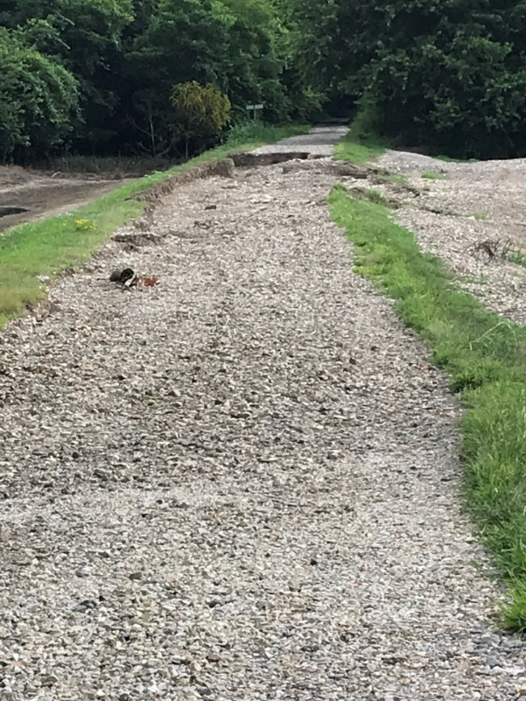
MM 137.6 Wainwright

Slide 26
MM 162.5 - Easley

Slide 27
What We Have Learned About Flooding:
Flooding is inevitable on portions of the Katy Trail, but as we upgrade our infrastructure, we seek the most flood resistant designs.
Includes concrete bridges that prove more sound in major flood events.
Replace stick built structures with precast restrooms for easy cleanup and minimal damage from floods.
When replacing heavy equipment and tools, we seek the most versatile and effective replacements for dealing with flood cleanup. We have learned to work smarter, not harder.

Slide 28
Lewis and Clark:
Rushville Mo, Buchanan County
189 acres
70 campsites
interpretive plaza and overlook
hiking trails
2 playgrounds
Rental shelter

Slide 29
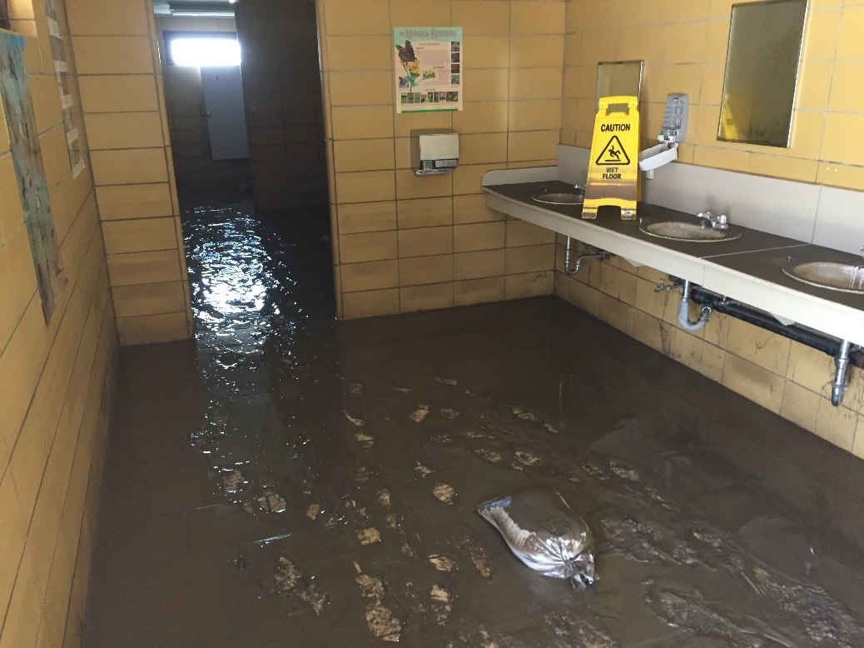
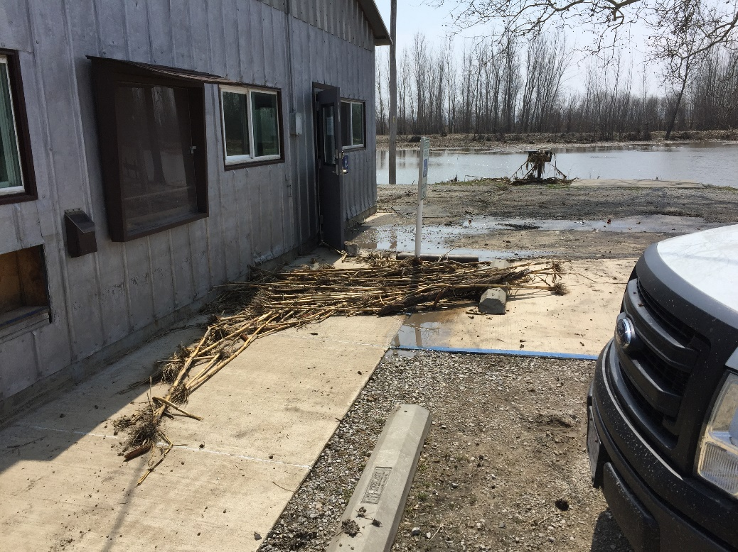
Post Flooding 2019

Slide 30
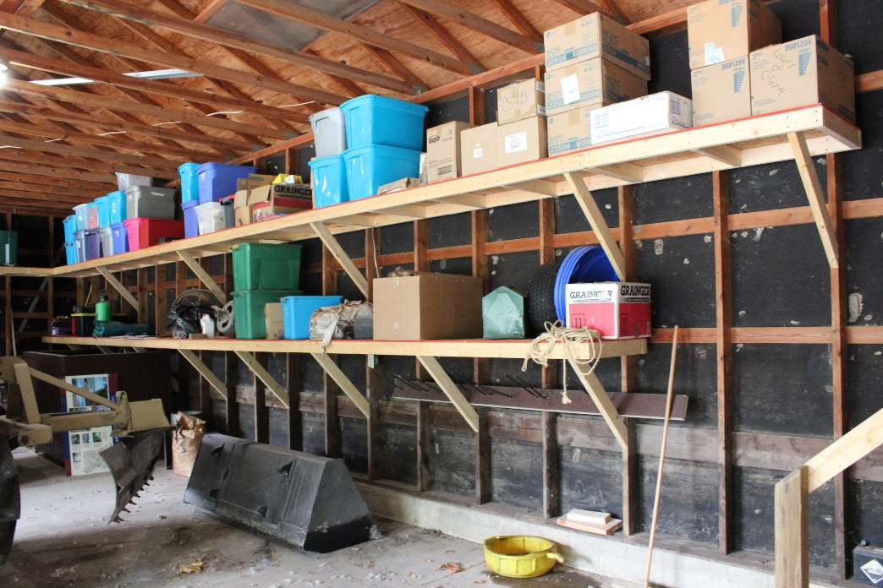
Elevated Storage Solutions

Slide 31
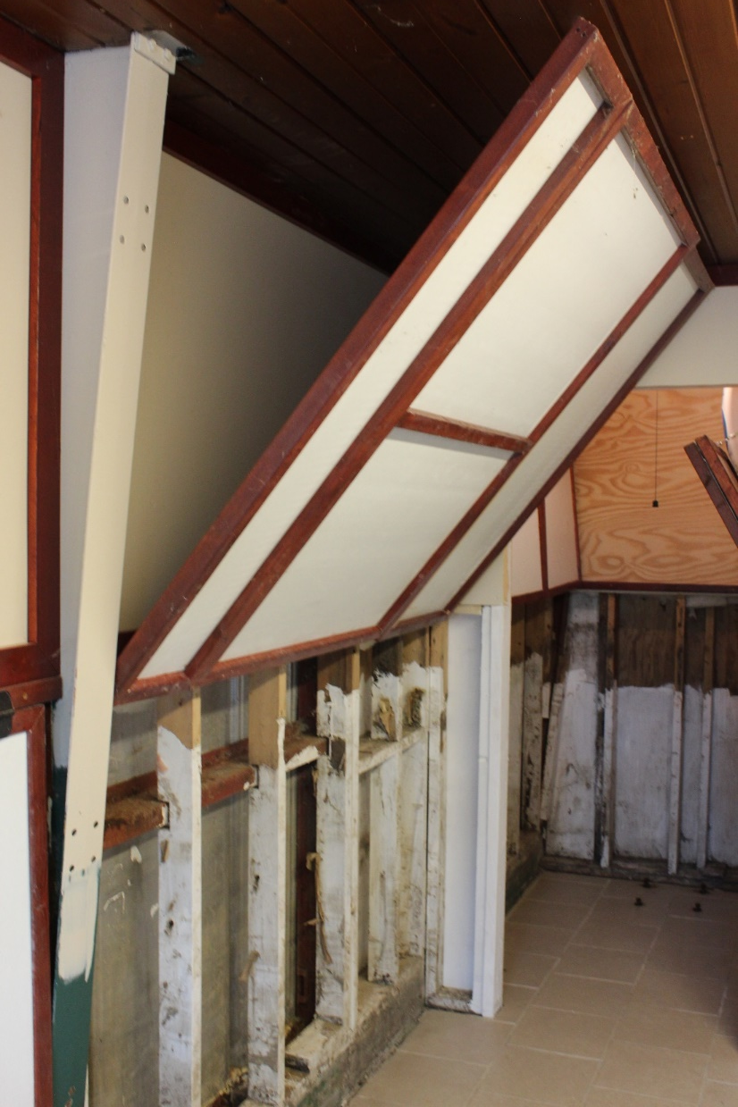
Lewis and Clark State Park Office: Hinged Paneling

Slide 32
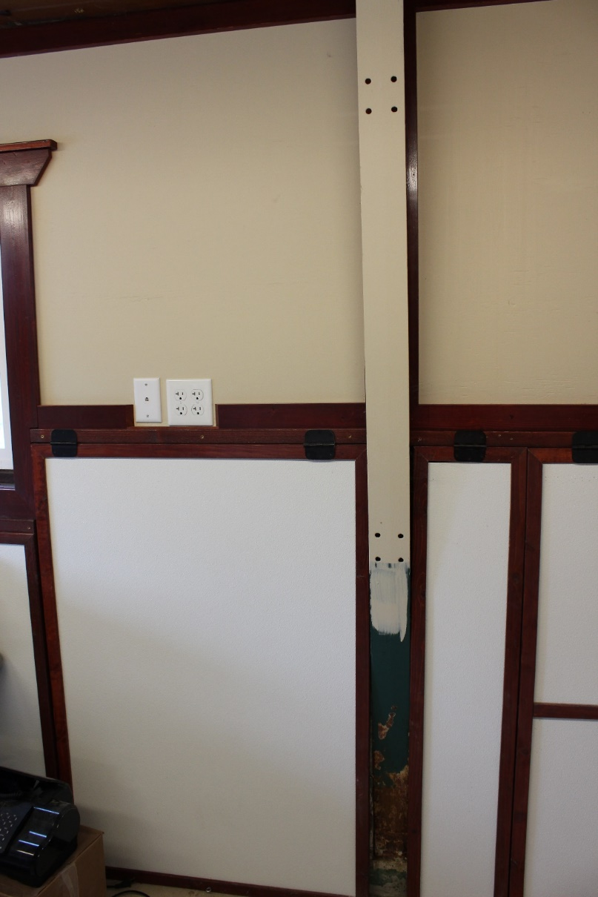
Elevated Electrical Service

Slide 33
Big Lake State Park:
Craig Mo, Holt County
407 acres
Sits on Big Lake, the largest remaining oxbow lake in Mo.
77 Campsites
8 camper cabins
Swimming pool
boat launch(only public launch on the lake)
2 playgrounds and rental shelter house
300 acre wetland marsh, which attracts an amazing display of migratory birds is threatened by flooding and siltation from the Missouri River.
Day use re-opened on Memorial Day Weekend 2021.
Overnight Lodging not offered until wastewater system is addressed.

Slide 34
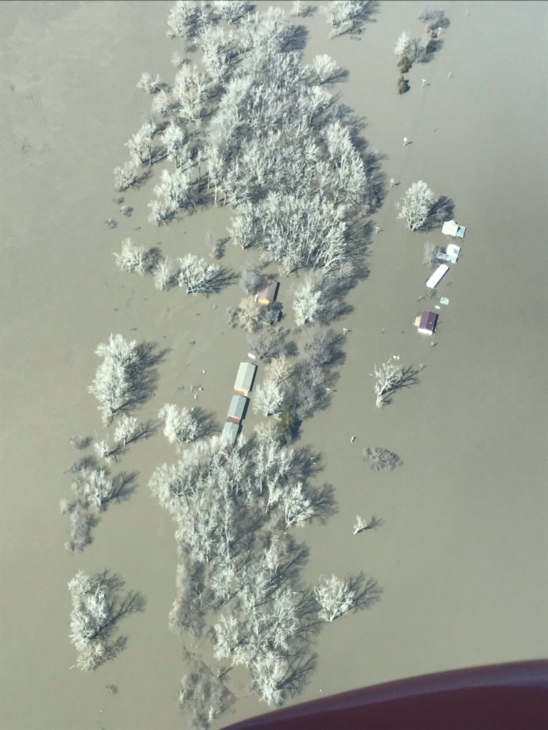
Big Lake State Park

Slide 35
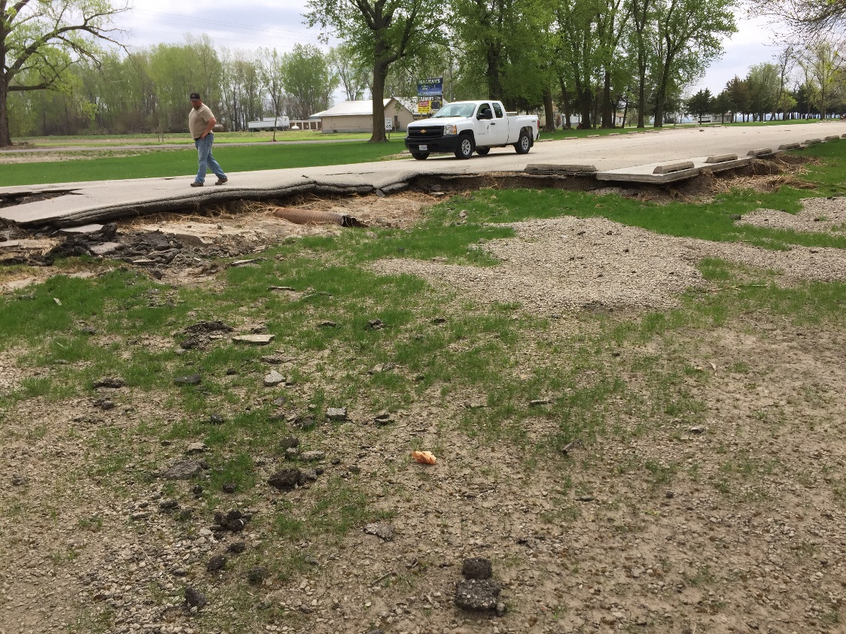
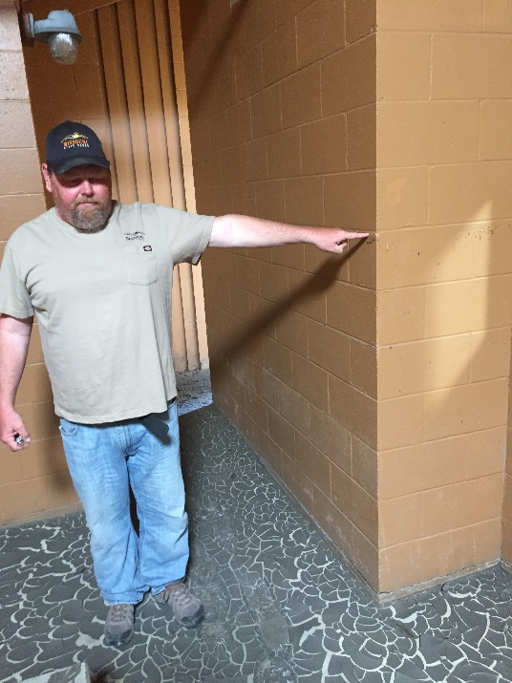

Slide 36
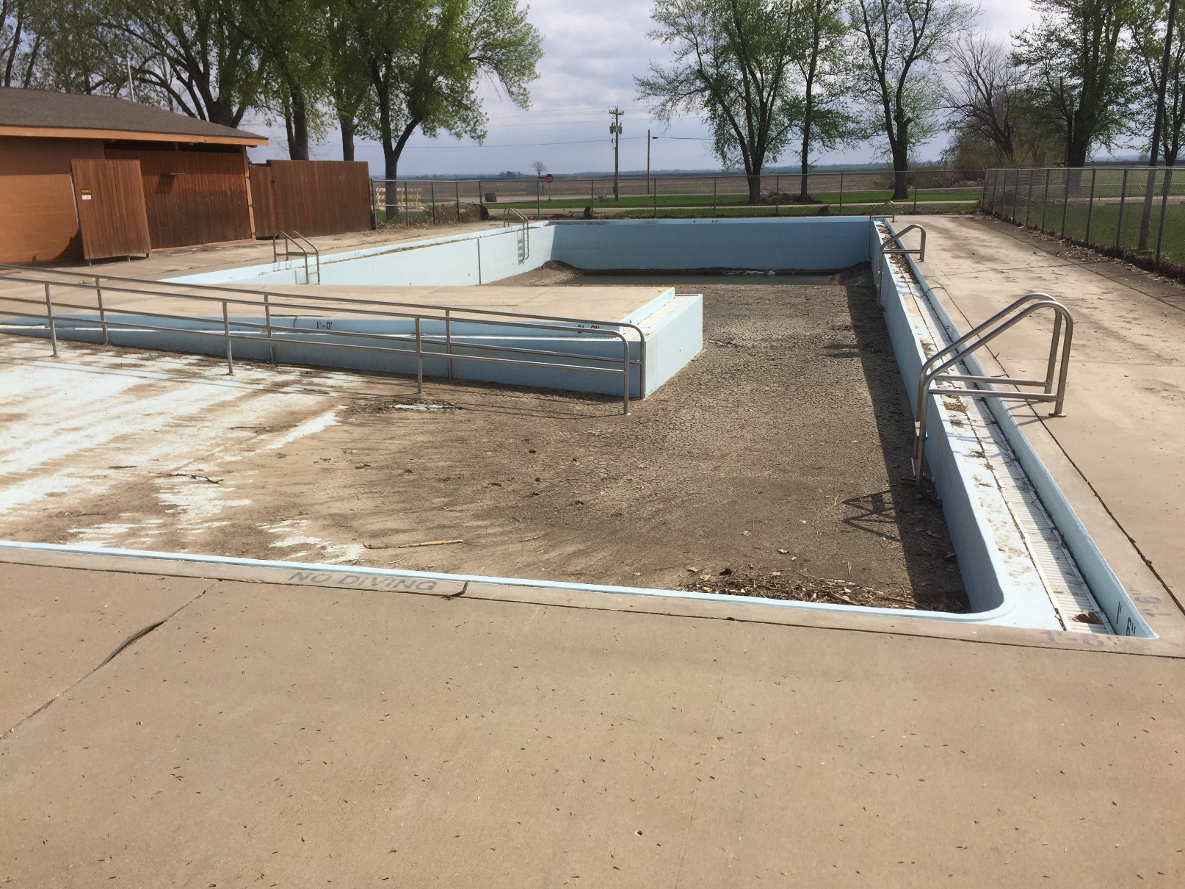

Slide 37
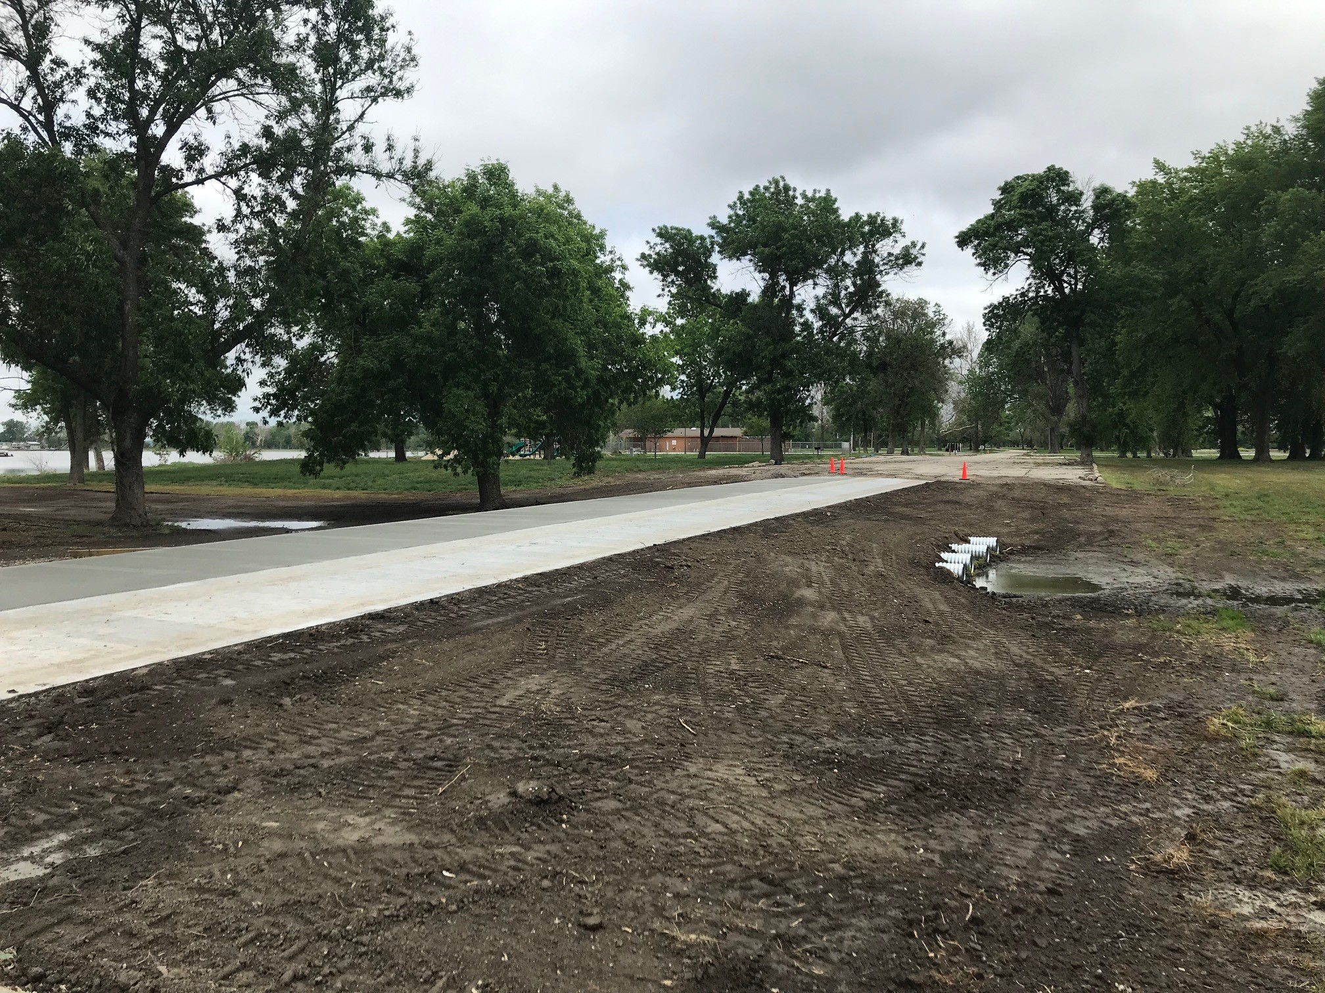

Slide 38
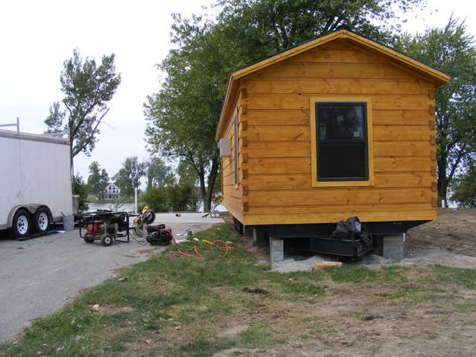
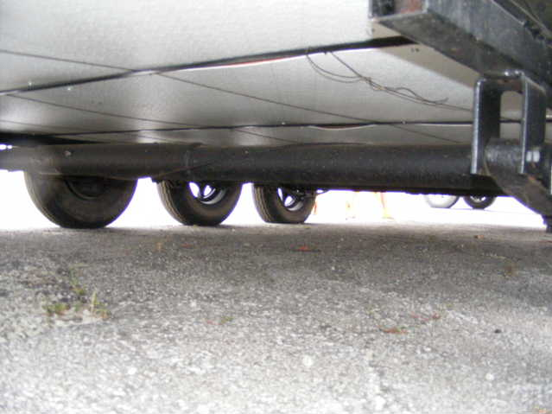
Lodging Solutions

Slide 39
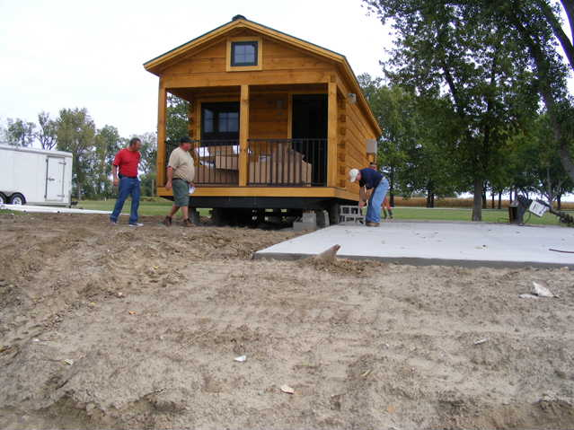
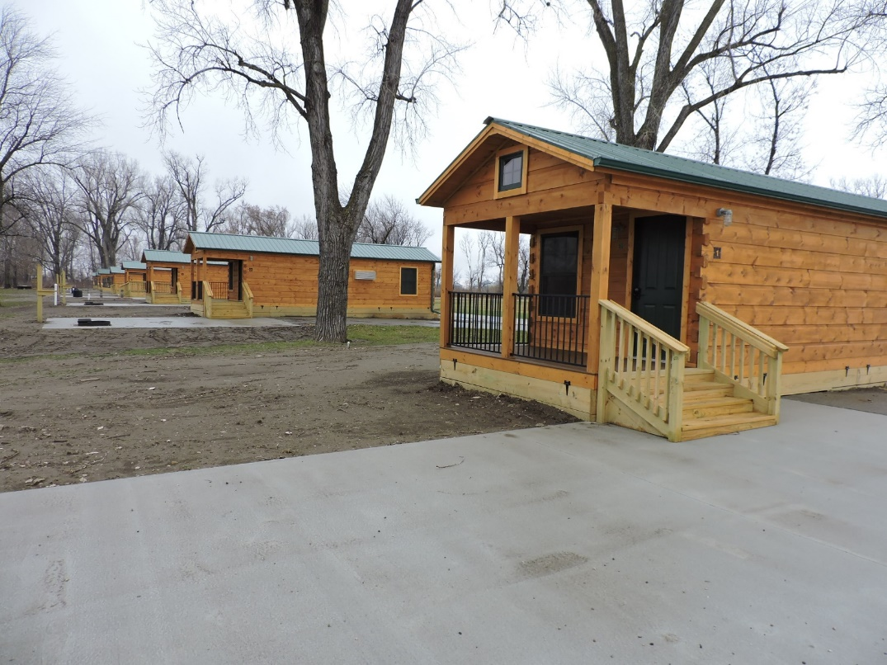
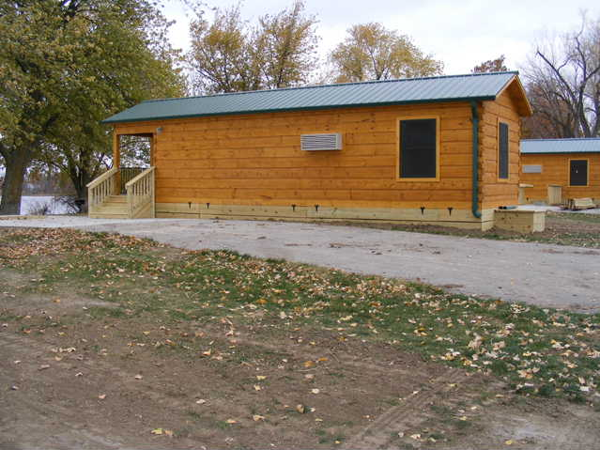

Slide 40
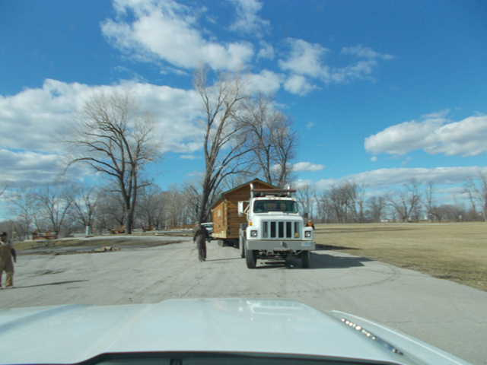
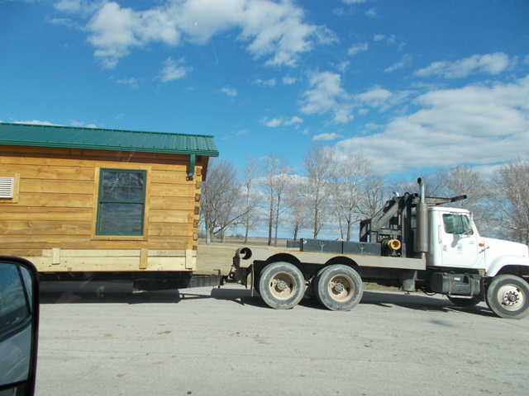
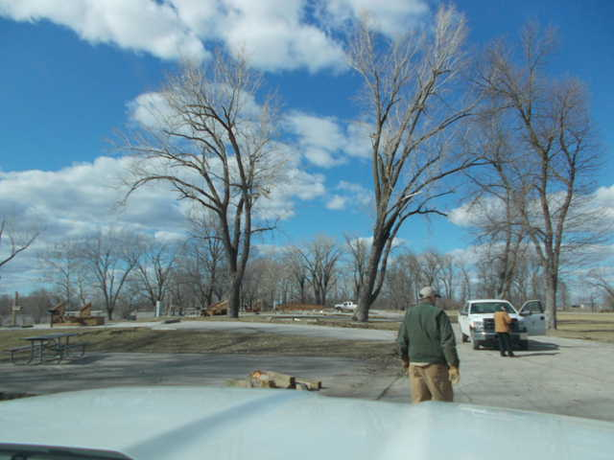

Slide 41
Questions, Comments?
Contact Dustin Webb
660-258-4954
dustin.webb@dnr.mo.gov

